Slide 1
Magento Deprecated Code & Replacement Approach
Suman Kar

Slide 2
Overview
Magento Professional Service: Code Audit, Migration & Implementation Services
Importance of the removal of deprecated classes and methods
Code Review & Identify deprecated classes and methods
Replace deprecated classes and methods with latest approach
Working Example
Q/A

Slide 3

Magento Services Overview : By Service Type
Magento Services Overview By Service Type
Architecture Services
Site Optimization Services
Migration & Implementation Services
Magento Commerce Cloud Deployment Services
Magento U Training/Adobe Learning
Architecture Advisory
Code Audit
Migration and Upgrade Services
Cloud Kickstart
Free Training Library
Dedicated Solution Architect
Solution Health Check
Implementation Services
Cloud Deployment Advisory
On-Demand Training
Infrastructure Review
Instructor-led Training
Certification
Training Units

Slide 4
Code Audit/Review Checklist
Review Magento core version and suggest for core upgrade
Review the custom code and check programing best practices are followed or not
Review the business logic and check the data flow in the system
Review Magento best practices are followed or not
Review PHP coding best practices if applicable
Review Magento deprecated methods and classes

Slide 5
What is deprecated Code ?
Deprecation, in its programming sense, is the process of taking older code and marking it as no longer being useful within the codebase, usually because it has been superseded by newer code. The deprecated code is not immediately removed from the codebase because doing so may cause regression errors.
Key Points needs to be remember
If custom code/extension have deprecated code, it is suggested to replaced those codes with alternate approach
Deprecated codes soon will be removed in the upcoming version
New development should not be done using deprecated code
Deprecated codes still can be working code, but it is recommends to not to use them as those will be removed in the upcoming version

Slide 6
Importance of Latest code and removal of deprecated code
Security
Performance improvements
Functional fixes and code enhancements
Enhancements in infrastructure
Improvements in Inventory Management

Slide 7
Importance of Latest code and removal of deprecated code
Will I be able to expand, change, or upgrade in the future?
Can my customers continue to trust my site for a hacker-free experience?
Is the site I depend on for my business secure?
Will my customizations and plug-ins continue to function worry-free and conflict-free?
Are my customers satisfied with the overall experience of navigating my site?
Does my site comply with Payment Card Industry Data Security Standards? (PCI DSS)

Slide 8
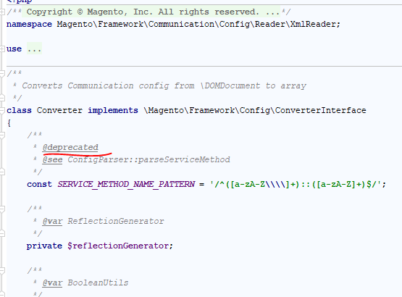
How to find Deprecated Code

Slide 9
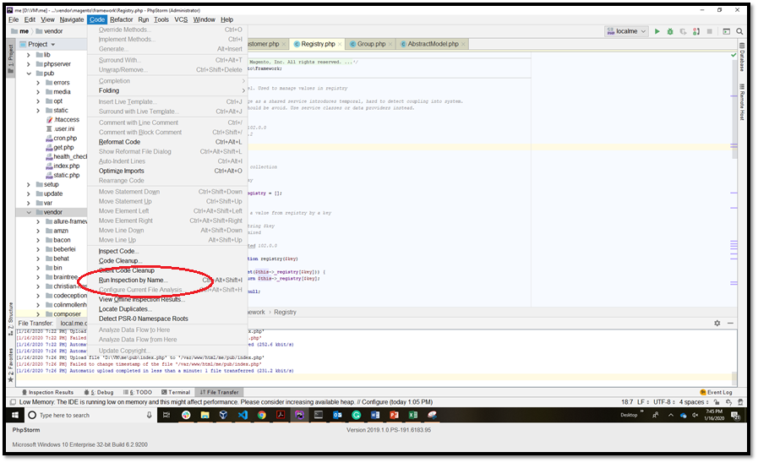
Find Deprecated Code in PhpStorm

Slide 10
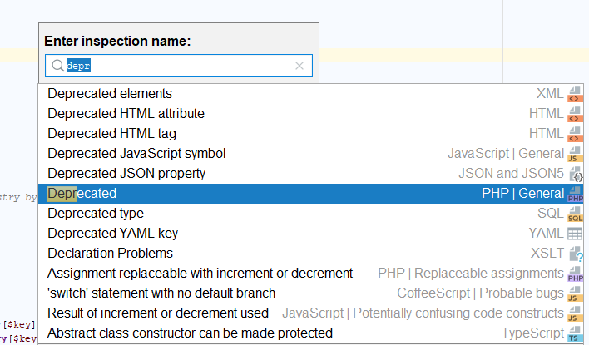
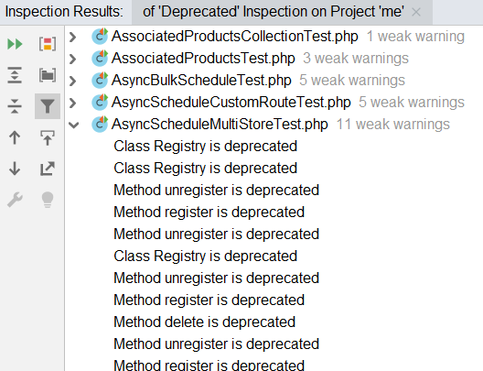
Find Deprecated Code in PHPStorm
Run Deprecated Inspection
Result

Slide 11
Lets talk about some deprecated classes and functions and replacement in Magento 2.3.3

Slide 12
Use of CartInterface instade of Magento\Checkout\Model\Cart
Deprecated Class :: Class Magento\Checkout\Model\Cart
Replacement Class :: Magento\Quote\Api\Data\CartInterface
Deprecated Class
Replacement Class
/** * @param \Magento\GoogleShoppingAds\Model\CookieSender $cookieSender * @param \Magento\Checkout\Model\Cart $cart */ public function __construct( \Magento\GoogleShoppingAds\Model\CookieSender $cookieSender, \Magento\Checkout\Model\Cart $cart ) { $this->cookieSender = $cookieSender; $this->cart = $cart; }
public function getQuoteItems(array $originalIds): array { $quote = $this->cart->getQuote(); }
/** * @param \Magento\Checkout\Model\Cart\CartInterface $cart */ public function __construct( \Magento\Checkout\Model\Cart\CartInterface $cart ) { $quote = $cart->getQuote(); }
<preference for="Magento\Quote\Api\Data\CartInterface" type="Magento\Quote\Model\Quote" />

Slide 13
Use of CartInterface instade of Magento\Checkout\Model\Cart
<preference for="Magento\Quote\Api\Data\CartInterface" type="Magento\Quote\Model\Quote" />
/** * Copyright © Magento, Inc. All rights reserved. * See COPYING.txt for license details. */ namespace Magento\Quote\Model; class Quote extends AbstractExtensibleModel implements \Magento\Quote\Api\Data\CartInterface {

Slide 14
CRUD operations
load(), delete(),save(),getCollection() methods on Model Object is deprecated

Slide 15
load(), delete(),save() methods on Model Object is deprecated
abstract class AbstractModel extends \Magento\Framework\DataObject { /** * @deprecated 101.0.0 because collections should be used directly via factory */ public function getCollection() { return $this->getResourceCollection(); } /** * Load object data * @deprecated 100.1.0 because entities must not be responsible for their own loading. * Service contracts should persist entities. Use resource model "load" or collections to implement * service contract model loading operations. */ public function load($modelId, $field = null) { $this->_getResource()->load($this, $modelId, $field); return $this; } /** * Save object data * @deprecated 100.1.0 because entities must not be responsible for their own persistence. * Service contracts should persist entities. Use resource model "save" to implement * service contract persistence operations. */ public function save() { $this->_getResource()->save($this); return $this; } /** * Delete object from database * * @deprecated 100.1.0 because entities must not be responsible for their own deletion. * Service contracts should delete entities. Use resource model "delete" method to implement * service contract persistence operations. */ public function delete() { $this->_getResource()->delete($this); return $this; } }

Slide 16
Alternate Approach for CRUD
Use Repository for save, load, delete and search
User Resource Model object for save, load, delete and search

Slide 17
Repository/Service contract Design Pattern
What is Repository ?
Why should I add a repository for my custom entity ?
It centralizes all the data access logic for the module to one place
If your entities will be used by other modules, then yes, you probably want to add a repository
There is another factor that should be added into the equation: in Magento 2, repositories can easily be exposed as Web API - that is REST and SOAP – resources
If that is interesting to you because of third party system integrations or a headless Magento setup, then again, yes, you probably want to add a repository for your entity

Slide 18
Repository/Service contract Design Pattern
namespace Magento\Cms\Model; /** * Class BlockRepository * @SuppressWarnings(PHPMD.CouplingBetweenObjects) */ class BlockRepository implements BlockRepositoryInterface {
namespace Magento\Cms\Api; use Magento\Cms\Api\Data\BlockInterface; interface BlockRepositoryInterface { /** * Save block. */ public function save(Data\BlockInterface $block); /** * Retrieve block. */ public function getById($blockId); /** * Retrieve blocks matching the specified criteria. */ public function getList(\Magento\Framework\Api\SearchCriteriaInterface $searchCriteria); /** * Delete block. */ public function delete(Data\BlockInterface $block); /** * Delete block by ID. */ public function deleteById($blockId); }
………………
……………
public function save(Data\BlockInterface $block) { if (empty($block->getStoreId())) { $block->setStoreId($this->storeManager->getStore()->getId()); } try { $this->resource->save($block); } catch (\Exception $exception) { throw new CouldNotSaveException(__($exception->getMessage())); } return $block; }
…….

Slide 19
Repository/Service contract
Load Entity
Search Entity
$model = $this->blockRepository->getById($id);
$notLoggedInFilter[] = $this->filterBuilder ->setField(GroupInterface::ID) ->setConditionType('neq') ->setValue(self::NOT_LOGGED_IN_ID) ->create(); $groupAll[] = $this->filterBuilder ->setField(GroupInterface::ID) ->setConditionType('neq') ->setValue(self::CUST_GROUP_ALL) ->create(); $groupNameSortOrder = $this->sortOrderBuilder ->setField('customer_group_code') ->setAscendingDirection() ->create(); $searchCriteria = $this->searchCriteriaBuilder ->addFilters($notLoggedInFilter) ->addFilters($groupAll) ->addSortOrder($groupNameSortOrder) ->create();
return $this->groupRepository->getList($searchCriteria)->getItems();
Save Entity
$model->setData($data);
$this->blockRepository->save($model);
Delete Entity
$category = $this->categoryRepository->get($categoryId); $this->categoryRepository->delete($category);

Slide 20
Exposing API using Repository
Webapi.xml
<route url="/V1/cmsPage/:pageId" method="GET"> <service class="Magento\Cms\Api\PageRepositoryInterface" method="getById"/> <resources> <resource ref="Magento_Cms::page"/> </resources> </route> <route url="/V1/cmsPage/search" method="GET"> <service class="Magento\Cms\Api\PageRepositoryInterface" method="getList"/> <resources> <resource ref="Magento_Cms::page"/> </resources> </route>

Slide 21
User Resource Model object for save, load, delete and search

Slide 22
Deprecated classes and methods : Use of load function on model
Deprecated Approach :: Use load function on model
Replacement Approach :: Use load function on resource model
Deprecated Approach
Replacement Approach
public function __construct( \Magento\User\Model\UserFactory $userFactory ) { $this->userFactory = $userFactory; } public function getAdminDetails($adminUserId) { $user = $this->userFactory->create()->load($adminUserId); $role = $user->getRole(); $data = $role->getData(); return $data; }
public function __construct( Magento\User\Model\UserFactory $userFactory, Magento\User\Model\ResourceModel\User $userResource ) { $this->userFactory = $userFactory; $this->userResource = $userResource; } /** * @return mixed */ public function getAdminDetails($adminUserId) { $user = $this->userFactory->create(); $this->userResource->load($user, $adminUserId);
$role = $user->getRole(); $data = $role->getData(); return $data; }

Slide 23
Deprecated classes and methods : Use of load function on model
Example
public function __construct( \Dotdigitalgroup\Email\Model\ResourceModel\Rules $rulesResource, \Magento\Backend\App\Action\Context $context, \Dotdigitalgroup\Email\Model\RulesFactory $rulesFactory, \Magento\Store\Model\StoreManagerInterface $storeManagerInterface, \Magento\Framework\Escaper $escaper ) { parent::__construct($context); $this->rulesResource = $rulesResource; $this->ruleFactory = $rulesFactory; $this->storeManager = $storeManagerInterface; $this->escaper = $escaper; }
$id = $this->getRequest()->getParam('id'); $ruleModel = $this->ruleFactory->create(); $this->rulesResource->load($ruleModel, $id);
Example Reference
Magento\GiftCardAccount\Model\GiftCardAccountRepository
Magento\Cms\Model\GetPageByIdentifier

Slide 24
Deprecated classes and methods : Use of load function on model
/** * Load an object * * @param \Magento\Framework\Model\AbstractModel $object * @param mixed $value * @param string $field field to load by (defaults to model id) * @return $this */ public function load(\Magento\Framework\Model\AbstractModel $object, $value, $field = null) { $object->beforeLoad($value, $field); if ($field === null) { $field = $this->getIdFieldName(); } $connection = $this->getConnection(); if ($connection && $value !== null) { $select = $this->_getLoadSelect($field, $value, $object); $data = $connection->fetchRow($select); if ($data) { $object->setData($data); } } $this->unserializeFields($object); $this->_afterLoad($object); $object->afterLoad(); $object->setOrigData(); $object->setHasDataChanges(false); return $this; }

Slide 25
Identify deprecated classes and methods : Use of save function on model
Deprecated Approach :: Use save function on model
Replacement Approach :: Use save function on resource model
Deprecated Approach
Replacement Approach
$job = $this->jobFactory->create(); $job->setJobCode($jobData['code']); $job->setWorkerClass($jobData['worker']); $job->setModule('Sivantos_Statements'); $job->setName($jobData['name']); $job->setIsEnabled(1);
$job->save();
$job = $this->jobFactory->create(); $job->setJobCode($jobData['code']); $job->setWorkerClass($jobData['worker']); $job->setModule('Xyz_Statements'); $job->setName($jobData['name']); $job->setIsEnabled(1);
$this->jobResource->save($job);

Slide 26
Identify deprecated classes and methods : Use of delete function on model
Deprecated Approach :: Use delete function on model
Replacement Approach :: Use delete function on resource model
Example Code
public function __construct( \Dotdigitalgroup\Email\Model\ResourceModel\Contact $contactResource, \Dotdigitalgroup\Email\Model\ImporterFactory $importerFactory, \Dotdigitalgroup\Email\Model\ContactFactory $contactFactory, \Dotdigitalgroup\Email\Helper\Data $data ) { $this->contactFactory = $contactFactory; $this->importerFactory = $importerFactory; $this->helper = $data; $this->contactResource = $contactResource; }
$contactModel = $this->contactFactory->create()->loadByCustomerEmail($email, $websiteId); if ($contactModel->getId()) { //remove contact $this->contactResource->delete($contactModel); }

Slide 27
Collections should be used directly via factory
Deprecated Approach
Replacement Approach
public function __construct( ProductFactory $productFactory, ) { $this->productFactory = $productFactory; } $collection = $this->productFactory->create()->getCollection()
public function __construct( \Magento\Catalog\Model\ResourceModel\Product\CollectionFactory $productCollectionFactory ) { $this->productCollectionFactory = $productCollectionFactory; } public function getProductCollection() { return $this->productCollectionFactory->create(); }
$product = $this->productCollectionFactory->create() ->setFlag('has_stock_status_filter') ->addIdFilter($stockItem->getProductId()) ->addFieldToSelect('type_id') ->getFirstItem();

Slide 28
Replacement Of MessageManager Function
Deprecated Class
Replacement Class
namespace Magento\Framework\Message; interface ManagerInterface { public function addMessages(array $messages, $group = null);
public function addError($message, $group = null);
public function addWarning($message, $group = null);
public function addNotice($message, $group = null);
namespace Magento\Framework\Message; interface ManagerInterface { public function addErrorMessage($message, $group = null); public function addWarningMessage($message, $group = null); public function addNoticeMessage($message, $group = null); public function addSuccessMessage($message, $group = null);

Slide 29
Use of Context Class
Deprecated Class :: Magento\Catalog\Block\Product\Context
Replacement Class :: Magento\Framework\View\Element\Template\Context
Deprecated Class
Replacement Class
/** * Recommended constructor. * * @param \Magento\Catalog\Block\Product\Context $context * @param Helper\Font $font */ public function __construct( \Magento\Catalog\Block\Product\Context $context ) { $this->font = $font; $this->urlFinder = $urlFinder; parent::__construct($context, $data); }
/** * @param \Magento\Framework\View\Element\Template\Context $context * @param \Magento\Framework\Registry $registry * @param array $data */ public function __construct( \Magento\Framework\View\Element\Template\Context $context, \Magento\Framework\Registry $registry, array $data = [] ) { $this->_coreRegistry = $registry; parent::__construct($context, $data); }

Slide 30
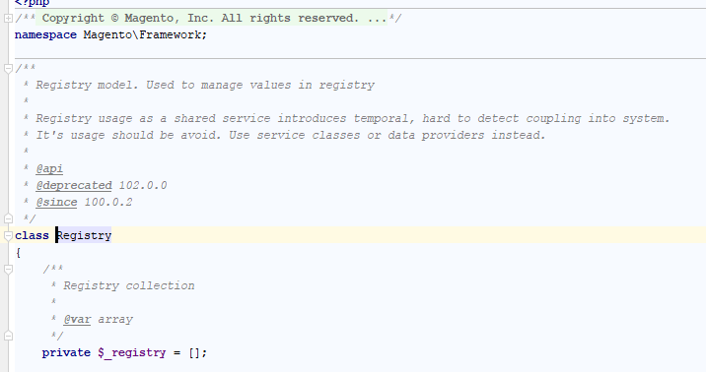
Deprecated Registry Class

Slide 31
Replacement Of Registry Class : Approach
In Magento core there are the following specific sessions on front-end:
Customer Session – Magento\Customer\Model\Session
Checkout Session – Magento\Checkout\Model\Session
Catalog Session – Magento\Catalog\Model\Session
Newsletter Session – Magento\Newsletter\Model\Session

Slide 32
Replacement Of Registry Class
declare(strict_types=1); /** * Abstract class service * @author Magento Service skar@adobe.com * @package ShipperHQ\Lib\Checkout */ namespace Adobe\Common\Model; abstract class AbstractService { /** * This function is used to set property to session object * @param $property * @return mixed */ abstract public function getProperty($property); /** * This function is used to get property value from session object * @param $property * @param $value * @return mixed */ abstract public function setProperty($property, $value); }

Slide 33
Replacement Of Registry Class
declare(strict_types=1); /** * Class CheckoutSessionService * Service class to set and get values from admin session * @author Magento Service skar@adobe.com * @package Adobe\Common\Model */ namespace Adobe\Common\Model; use Magento\Catalog\Model\Session; use Magento\Framework\Api\SimpleDataObjectConverter; class CatalogSessionService extends AbstractService { /** * Catalog session * * @var Session */ protected $catalogSession; /** * CheckoutSessionService constructor. * @param Session $catalogSession */ public function __construct(Session $catalogSession) { $this->catalogSession = $catalogSession; } /**
/** * @inheritDoc */ public function getProperty($property) { $getter = 'get' . SimpleDataObjectConverter::snakeCaseToUpperCamelCase($property); return $this->catalogSession->$getter(); } /** * @inheritDoc */ public function setProperty($property, $value) { $setter = 'set' . SimpleDataObjectConverter::snakeCaseToUpperCamelCase($property); $this->catalogSession->$setter($value); }
Reference Doc
https://www.atwix.com/magento-2/alternatives-for-deprecated-registry-class-magento-2-3/
https://github.com/Vinai/module-current-product-example

Slide 34
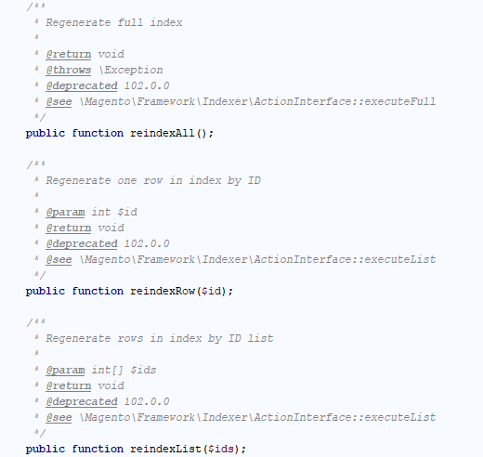
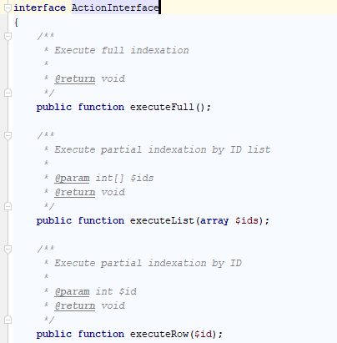
Replacement for Magento\Framework\Indexer\IndexerInterface
Deprecated Class :: Magento\Framework\Indexer\IndexerInterface
Replacement Class :: Magento\Framework\Indexer\ActionInterface
Deprecated Approach
Replacement Approach

Slide 35
Some more changes
Replacement for Inventory Class
Magento introduced Multi-Source Inventory
Magento deprecated all Inventory add, update, delete related classes
Reference can be found in the URL : https://devdocs.magento.com/guides/v2.3/inventory/inventory-api-reference.html
Use of declarative schema
Use declarative schema replace of setup install, upgrade script

Slide 36
Key Points
Code Audit, Code Upgrade and implementation are major service provided my Magento Service Team
Deprecated codes are outdated code/old approach that exists in the framework
Deprecated codes are still working, soon in the future will be removed
If custom developed code contains deprecated code those need to be replaced with the new approach according Magento latest version
New development should not be done using deprecated code

Slide 37
Q/A

